Slide 1

Analytic Simulation
MTH 564 – Mathematical Modeling

Slide 2
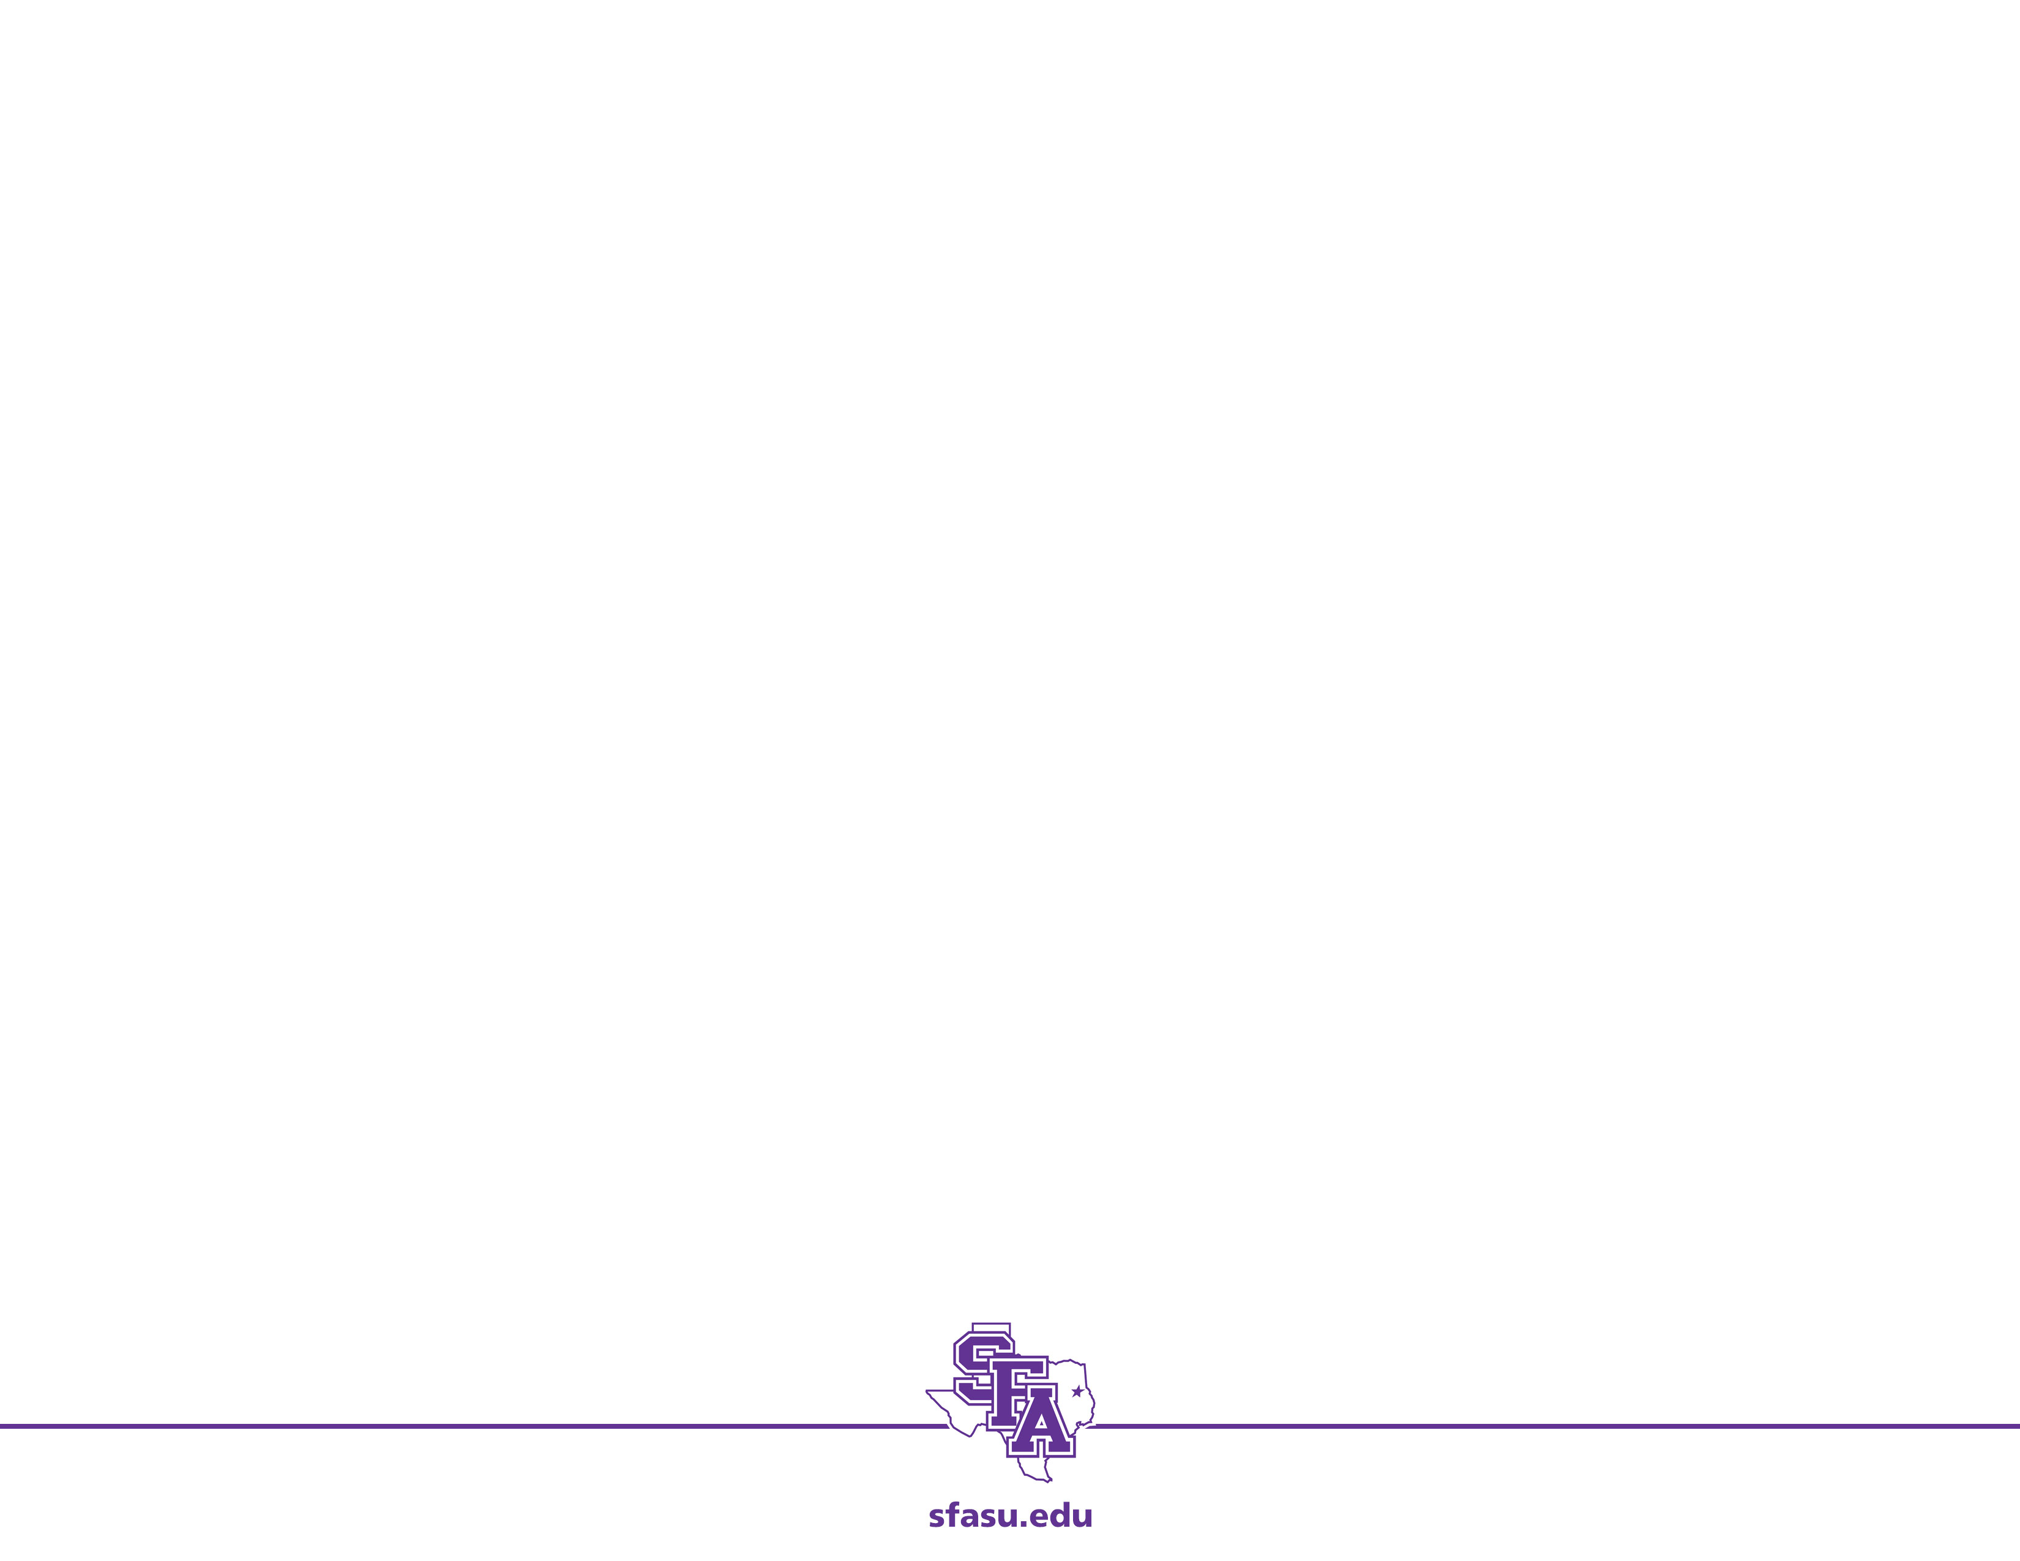
Overview
Monte Carlo simulation models are relatively easy to formulate, intuitively appealing, but require a large number of model runs to obtain reliable results, especially when conducting sensitivity analysis.
Analytic simulations are more difficult to formulate but are computationally more efficient.

Slide 3
Problem: Bombing Runs
A military operations analyst plans an air strike against a well-defended target. High-altitude strategic bombers will be sent to attach this important target. It is important to ensure the success of this attach early in the battle, preferable on the first day. Each individual aircraft has a 0.5 probability of destroying the target, assuming that it can get through the air defense and then acquire the target. The probability that a single aircraft will acquire the target is 0.9. The target is defended by 2 surface-to-air missile (SAM) batteries and a number of air defense guns. The flight profile of the aircraft will prevent the air defense guns from being effective (because the planes will be too high). Each SAM battery has its own tracking radar and computer guidance equipment, which is capable of tracking 2 aircrafts and guiding 2 missiles simultaneously. Intelligence estimates a 0.6 probability that 1 missile will disable its target aircraft. Both SAM batteries share a target acquisition radar that is highly effective against high-altitude bombers at a range of up to 50 miles. The effective range of the tracking radar is 15 miles. The bombers will travel a 500 miles/hour at an altitude of 5 miles, and the attack requires that they loiter in the target area for 1 minutes. Each SAM battery can launch 1 missile every 30 seconds, and the missiles travel at 1,000 miles/hour. How many bombers should be sent against this target to ensure its destructions.

Slide 4
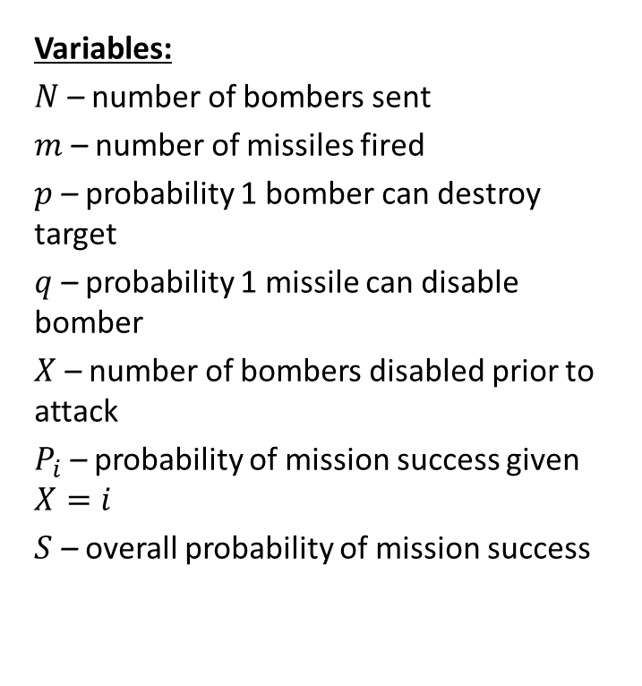
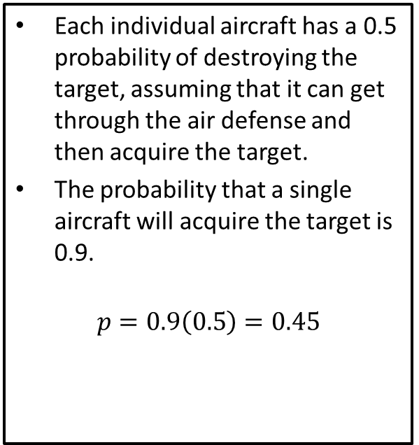
Step 1: Ask the question.
Variables:
$N$ – number of bombers sent
$m$ – number of missiles fired
$p$ – probability 1 bomber can destroy target
$q$ – probability 1 missile can disable bomber
$X$ – number of bombers disabled prior to attack
$P_{i}$ – probability of mission success given $X=i$
$S$ – overall probability of mission success
Each individual aircraft has a 0.5 probability of destroying the target, assuming that it can get through the air defense and then acquire the target.
The probability that a single aircraft will acquire the target is 0.9.
$$p=0.9\left(0.5\right)=0.45$$

Slide 5
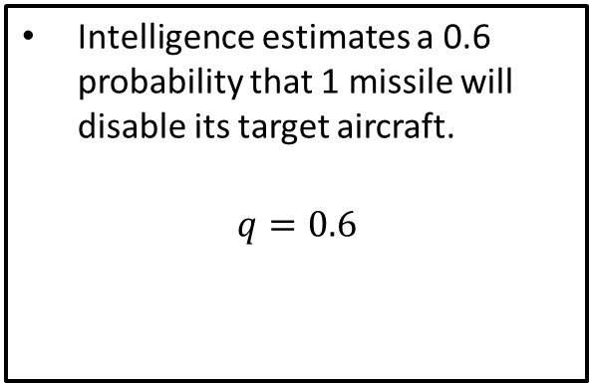
Step 1: Ask the question.
Variables:
$N$ – number of bombers sent
$m$ – number of missiles fired
$p$ – probability 1 bomber can destroy target
$q$ – probability 1 missile can disable bomber
$X$ – number of bombers disabled prior to attack
$P_{i}$ – probability of mission success given $X=i$
$S$ – overall probability of mission success
Intelligence estimates a 0.6 probability that 1 missile will disable its target aircraft.
$$q=0.6$$

Slide 6
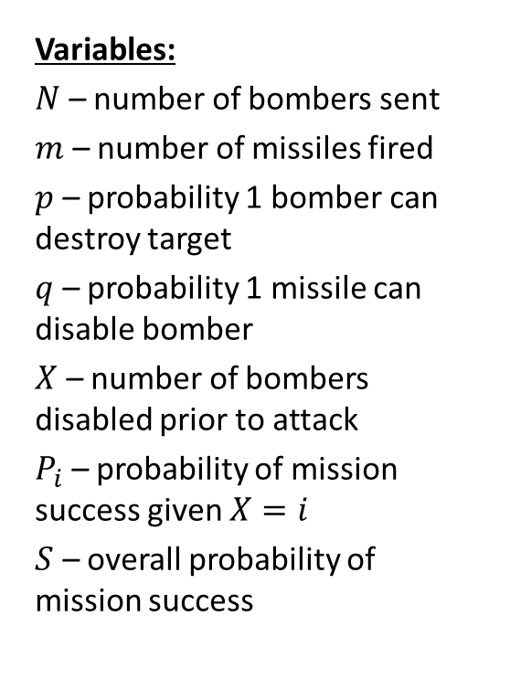
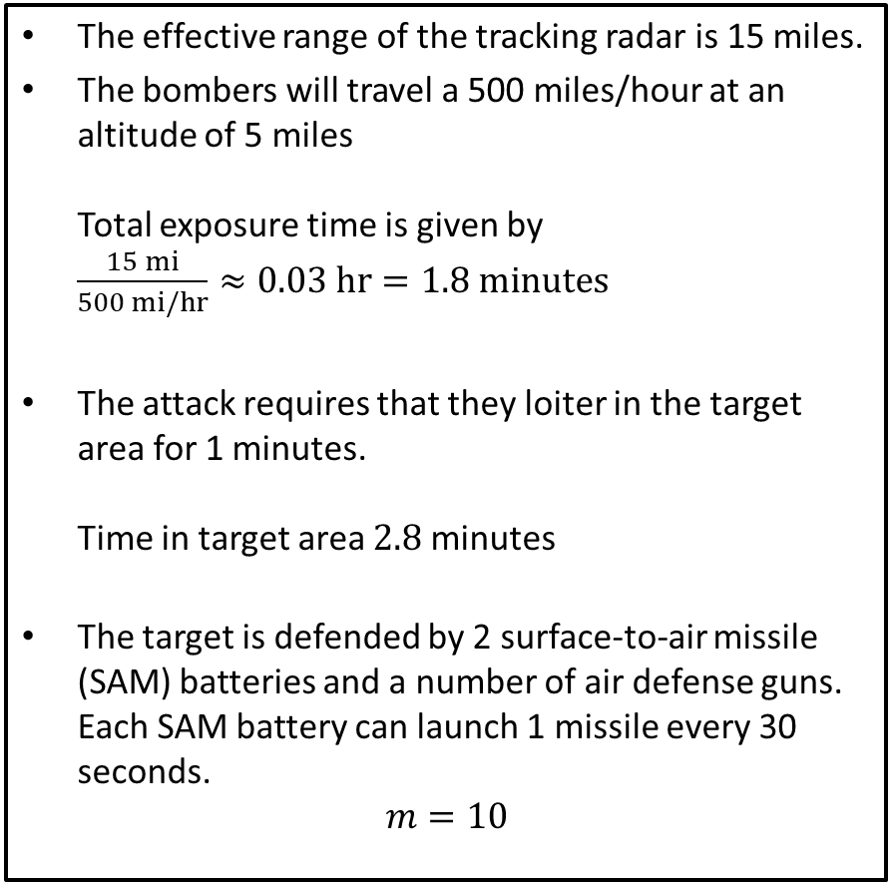
Step 1: Ask the question.
Variables:
$N$ – number of bombers sent
$m$ – number of missiles fired
$p$ – probability 1 bomber can destroy target
$q$ – probability 1 missile can disable bomber
$X$ – number of bombers disabled prior to attack
$P_{i}$ – probability of mission success given $X=i$
$S$ – overall probability of mission success
The effective range of the tracking radar is 15 miles.
The bombers will travel a 500 miles/hour at an altitude of 5 miles Total exposure time is given by $\frac{15 mi}{500 mi/hr}≈0.03 hr=1.8 minutes$
The attack requires that they loiter in the target area for 1 minutes. Time in target area $2.8$ minutes
The target is defended by 2 surface-to-air missile (SAM) batteries and a number of air defense guns. Each SAM battery can launch 1 missile every 30 seconds.
$$m=10$$

Slide 7
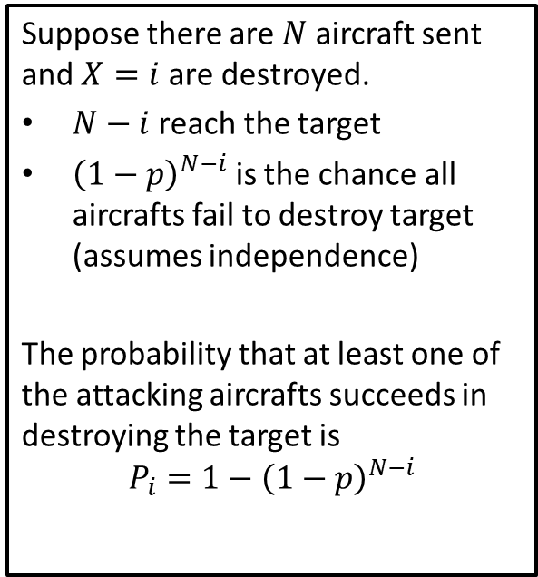
Step 1: Ask the question.
Variables:
$N$ – number of bombers sent
$m$ – number of missiles fired
$p$ – probability 1 bomber can destroy target
$q$ – probability 1 missile can disable bomber
$X$ – number of bombers disabled prior to attack
$P_{i}$ – probability of mission success given $X=i$
$S$ – overall probability of mission success
Suppose there are $N$ aircraft sent and $X=i$ are destroyed.
$N−i$reach the target
${\left(1−p\right)}^{N−i}$ is the chance all aircrafts fail to destroy target (assumes independence)
The probability that at least one of the attacking aircrafts succeeds in destroying the target is
$$P_{i}=1−{\left(1−p\right)}^{N−i}$$

Slide 8
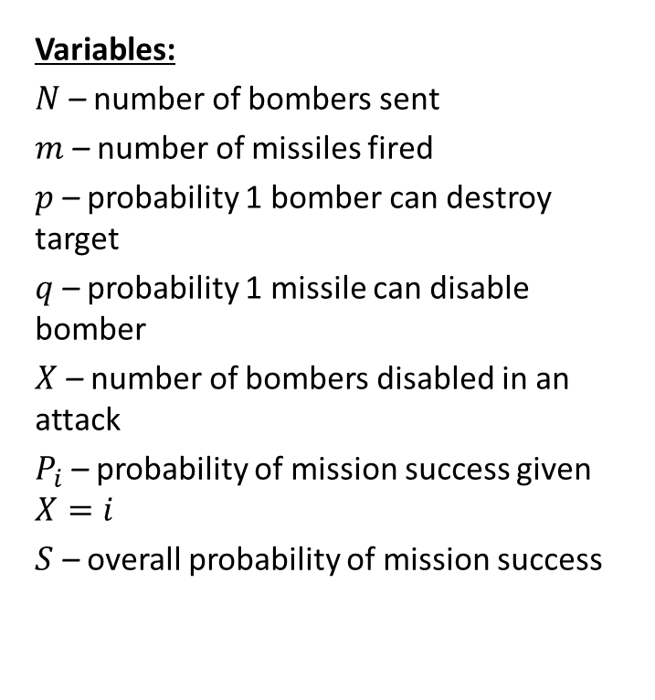
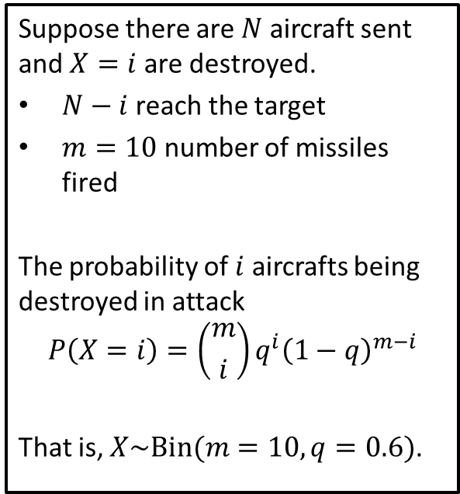
Step 1: Ask the question.
Variables:
$N$ – number of bombers sent
$m$ – number of missiles fired
$p$ – probability 1 bomber can destroy target
$q$ – probability 1 missile can disable bomber
$X$ – number of bombers disabled in an attack
$P_{i}$ – probability of mission success given $X=i$
$S$ – overall probability of mission success
Suppose there are $N$ aircraft sent and $X=i$ are destroyed.
$N−i$reach the target
$m=10$ number of missiles fired
The probability of $i$ aircrafts being destroyed in attack
$$P\left(X=i\right)=\left({m \atop i}\right)q^{i}{\left(1−q\right)}^{m−i}$$
That is, $X\sim Bin(m=10, q=0.6)$.

Slide 9
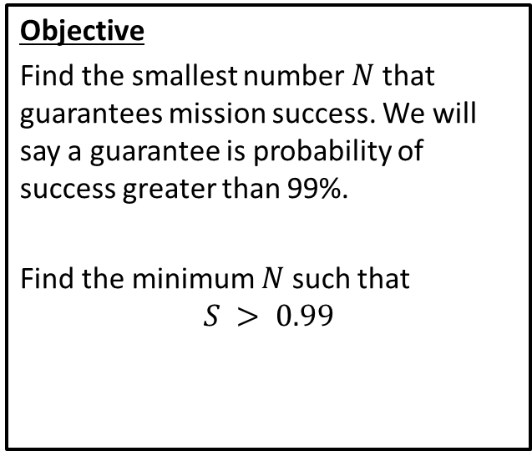
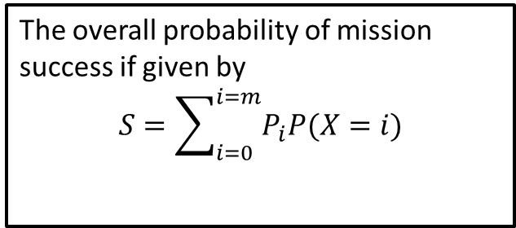
Step 1: Ask the question.
Variables:
$N$ – number of bombers sent
$m$ – number of missiles fired
$p$ – probability 1 bomber can destroy target
$q$ – probability 1 missile can disable bomber
$X$ – number of bombers disabled in an attack
$P_{i}$ – probability of mission success given $X=i$
$S$ – overall probability of mission success
The overall probability of mission success if given by
$$S=\sum_{i=0}^{i=m}{P_{i}P(X=i)}$$
Objective
Find the smallest number $N$ that guarantees mission success. We will say a guarantee is probability of success greater than 99%.
Find the minimum $N$ such that $$S > 0.99$$

Slide 10
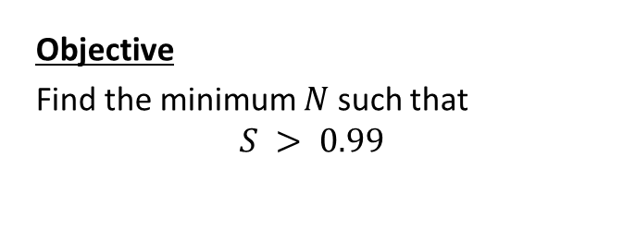
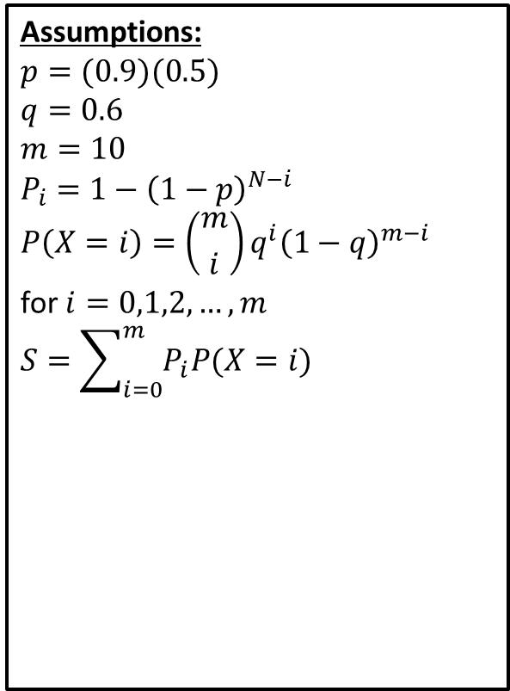
Step 1: Ask the question.
Variables:
$N$ – number of bombers sent
$m$ – number of missiles fired
$p$ – probability 1 bomber can destroy target
$q$ – probability 1 missile can disable bomber
$X$ – number of bombers disabled prior to attack
$P_{i}$ – probability of mission success given $X=i$
$S$ – overall probability of mission success
Assumptions:
$$p=(0.9)(0.5)$$
$$q=0.6 \\ m=10 \\ P_{i}=1−{\left(1−p\right)}^{N−i}$$
$$P\left(X=i\right)=\left({m \atop i}\right)q^{i}{\left(1−q\right)}^{m−i}$$
for $i=0,1,2,…,m$
$$S=\sum_{i=0}^{m}{P_{i}P(X=i)}$$
Objective
Find the minimum $N$ such that $$S > 0.99$$

Slide 11
Step 2: Select the modeling approach
We will use an analytic simulation.
In a Monte Carlo simulation we draw random numbers to simulate events and use repeated trials to estimate probabilities and expected values.
In an analytic simulation we use a combination of probability theory and computer programming to calculate probabilities and expected values.
Analytic simulations are more mathematically sophisticated, which accounts for greater efficiency.
Most times Monte Carlo simulation is a last resort, to be employed if they are unable to formulate a suitable analytic model.
Assumptions:
$$p=(0.9)(0.5)$$
$$q=0.6 \\ m=10 \\ P_{i}=1−{\left(1−p\right)}^{N−i}$$
$$P\left(X=i\right)=\left({m \atop i}\right)q^{i}{\left(1−q\right)}^{m−i}$$
for $i=0,1,2,…,m$
$$S=\sum_{i=0}^{m}{P_{i}P(X=i)}$$
Objective
Find the minimum $N$ such that $$S > 0.99$$

Slide 12
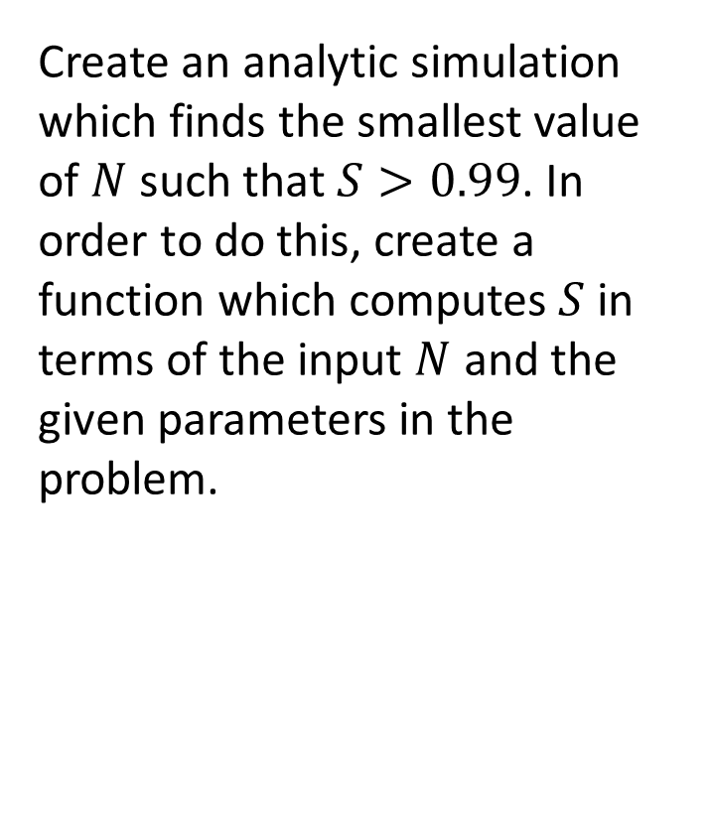
Step 3: Formulate the model
Create an analytic simulation which finds the smallest value of $N$ such that $S>0.99$. In order to do this, create a function which computes $S$ in terms of the input $N$ and the given parameters in the problem.
Assumptions:
$$p=(0.9)(0.5)$$
$$q=0.6 \\ m=10 \\ P_{i}=1−{\left(1−p\right)}^{N−i}$$
$$P\left(X=i\right)=\left({m \atop i}\right)q^{i}{\left(1−q\right)}^{m−i}$$
for $i=0,1,2,…,m$
$$S=\sum_{i=0}^{m}{P_{i}P(X=i)}$$
Objective
Find the minimum $N$ such that $$S > 0.99$$

Slide 13
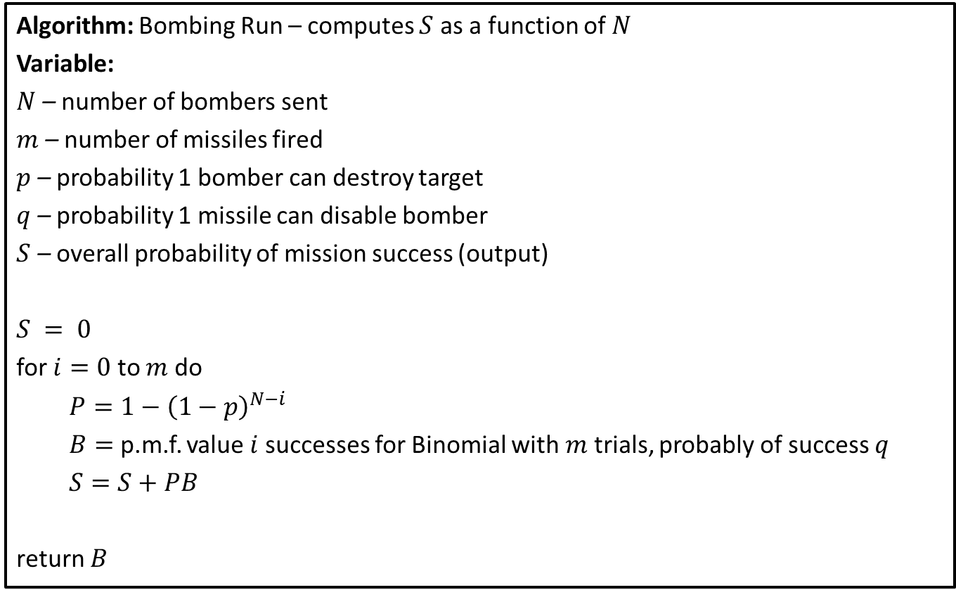
Step 4: Solve the Problem (Pseudo-Code)
Algorithm: Bombing Run – computes $S$ as a function of $N$
Variable:
$N$ – number of bombers sent
$m$ – number of missiles fired
$p$ – probability 1 bomber can destroy target
$q$ – probability 1 missile can disable bomber
$S$ – overall probability of mission success (output)
$S = 0$
for $i=0$ to $m$ do
$P=1−{\left(1−p\right)}^{N−i}$
$B=$ p.m.f. value $i$ successes for Binomial with $m$ trials, probably of success $q$
$S=S+PB$
return $B$

Slide 14
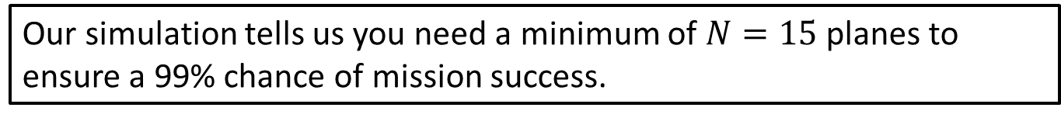
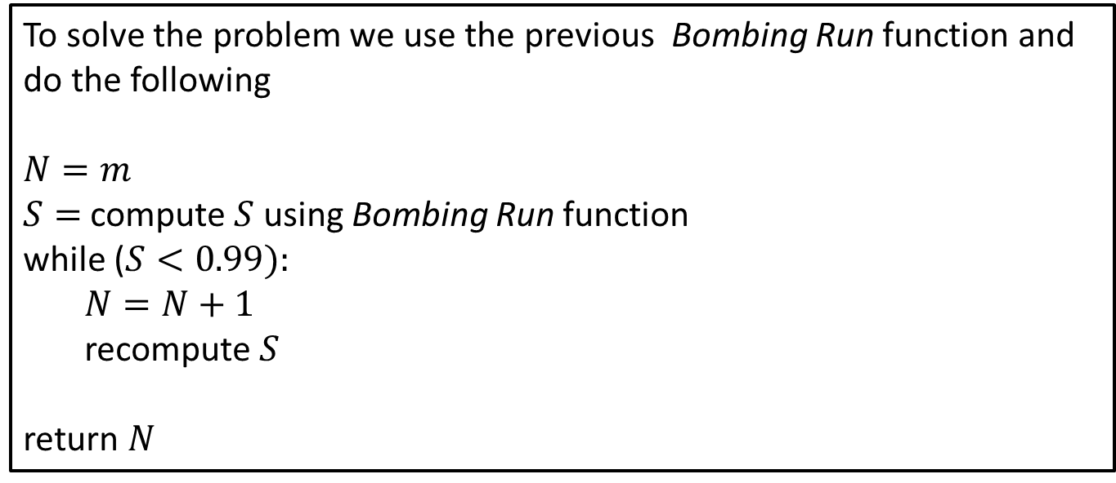
Step 4: Solve the Problem (Pseudo-Code)
To solve the problem we use the previous Bombing Run function and do the following
$N=m$
$S=$ compute $S$ using Bombing Run function
while ($S<0.99):$
$N=N+1$
recompute $S$
return $N$
Our simulation tells us you need a minimum of $N=15$ planes to ensure a 99% chance of mission success.
Notes:
See python file section1-1pig.py

Slide 15
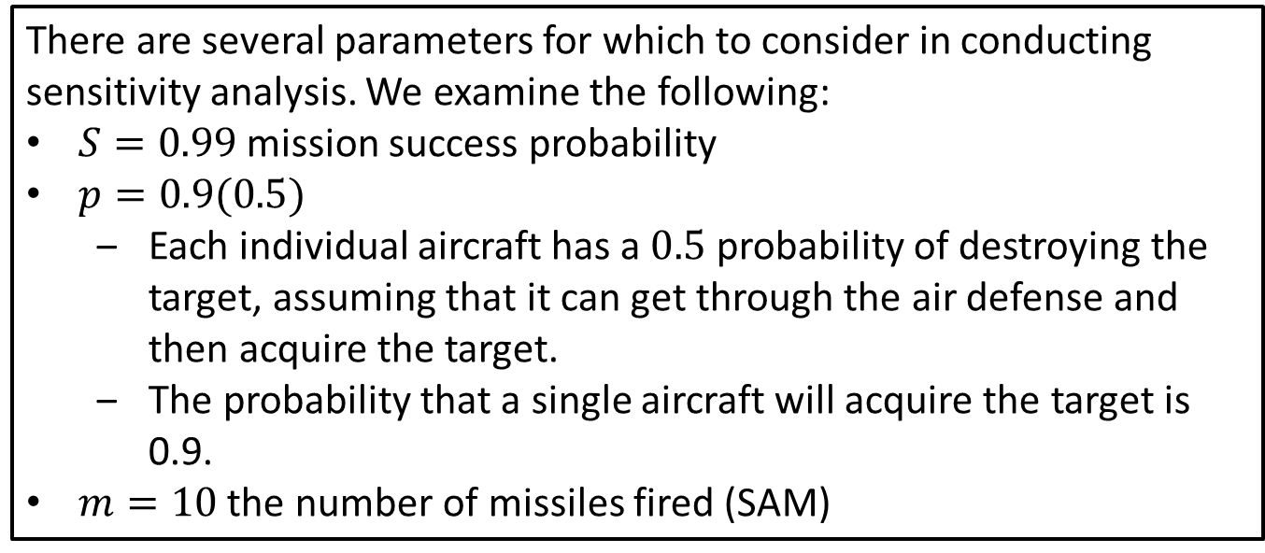
Step 5: Answer the question
To ensure a 99% chance of mission success, 15 bombers are required.
There are several parameters for which to consider in conducting sensitivity analysis. We examine the following:
$S=0.99$ mission success probability
$p=0.9(0.5)$
Each individual aircraft has a $0.5$ probability of destroying the target, assuming that it can get through the air defense and then acquire the target.
The probability that a single aircraft will acquire the target is 0.9.
$m=10$ the number of missiles fired (SAM)
Notes:
See python file section1-1pig.py

Slide 16
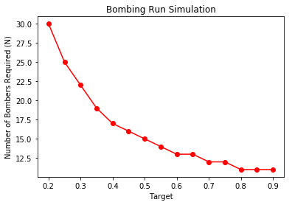
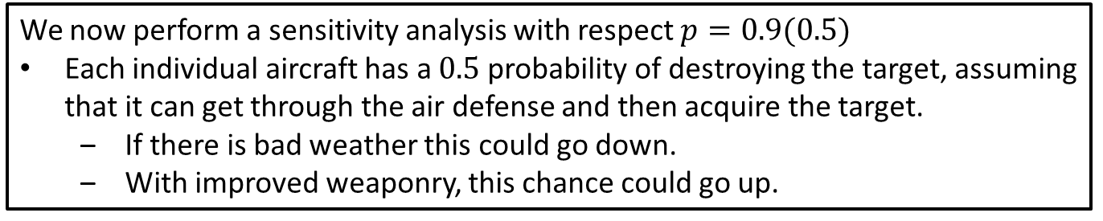

Sensitivity: Parameter $p$
We now perform a sensitivity analysis with respect $p=0.9(0.5)$
Each individual aircraft has a $0.5$ probability of destroying the target, assuming that it can get through the air defense and then acquire the target.
If there is bad weather this could go down.
With improved weaponry, this chance could go up.
It appears our solution is sensitive to decreases in this probability, but not very sensitive to increases.
Notes:
See python file section1-1pig.py

Slide 17
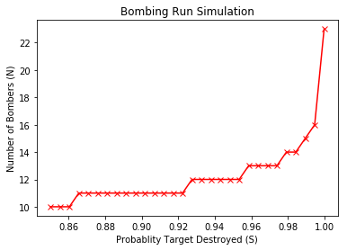


Sensitivity: Parameter $S$
We now perform a sensitivity analysis with respect $S=0.99$
We decided that a guarantee for mission success is a $99\%$ chance.
We
It appears our solution is sensitive to increases in this probability, but not very sensitive to decreases.
Notes:
See python file section1-1pig.py

Slide 18
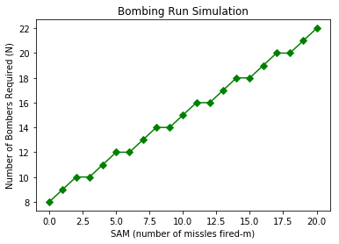
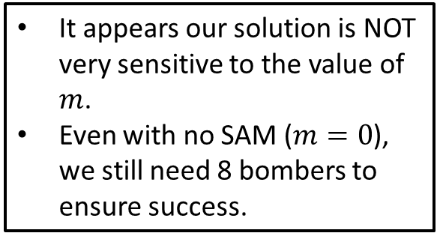
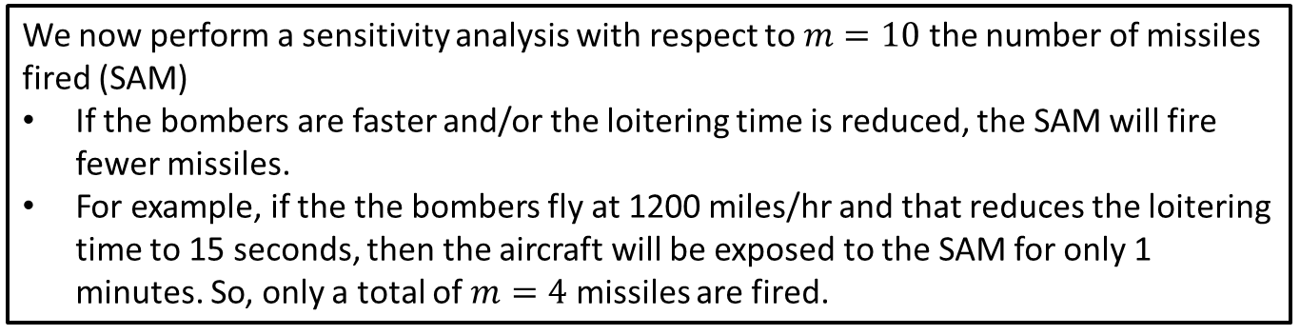

Sensitivity: Parameter $m$
We now perform a sensitivity analysis with respect to $m=10$ the number of missiles fired (SAM)
If the bombers are faster and/or the loitering time is reduced, the SAM will fire fewer missiles.
For example, if the the bombers fly at 1200 miles/hr and that reduces the loitering time to 15 seconds, then the aircraft will be exposed to the SAM for only 1 minutes. So, only a total of $m=4$ missiles are fired.
It appears our solution is NOT very sensitive to the value of $m$.
Even with no SAM ($m=0$), we still need 8 bombers to ensure success.
Notes:
See python file section1-1pig.py

Slide 19
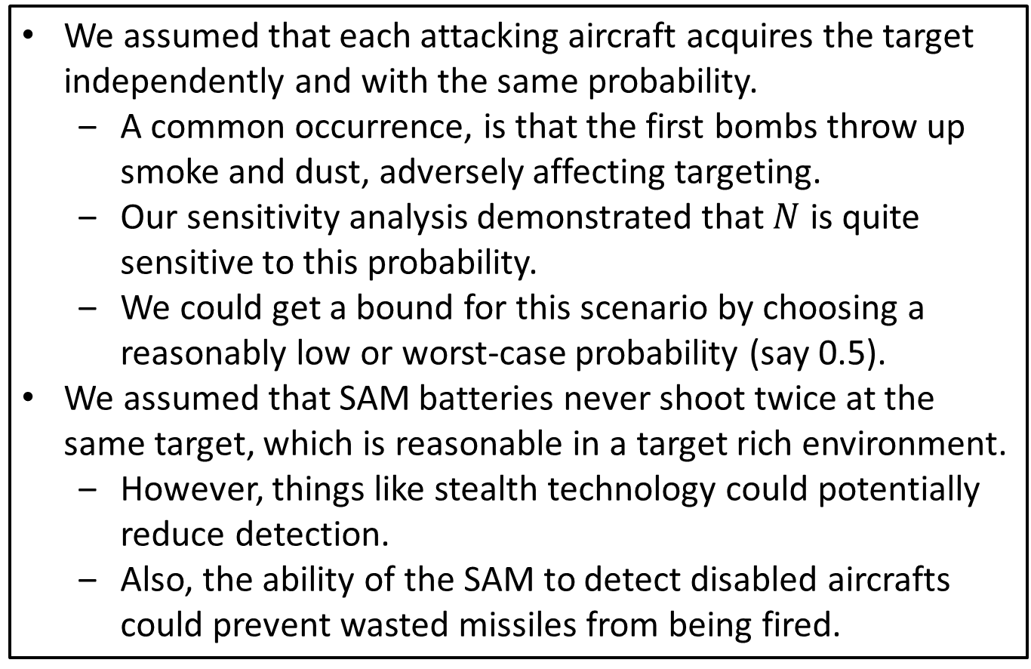
Robustness Considerations
We assumed that each attacking aircraft acquires the target independently and with the same probability.
A common occurrence, is that the first bombs throw up smoke and dust, adversely affecting targeting.
Our sensitivity analysis demonstrated that $N$ is quite sensitive to this probability.
We could get a bound for this scenario by choosing a reasonably low or worst-case probability (say 0.5).
We assumed that SAM batteries never shoot twice at the same target, which is reasonable in a target rich environment.
However, things like stealth technology could potentially reduce detection.
Also, the ability of the SAM to detect disabled aircrafts could prevent wasted missiles from being fired.
Notes:
See python file section1-1pig.py

